Slide 1


Continuous Probability
AC52012: Research Methods
Notes:
In this final video of the week, we’re going to move on from what we’ve covered – discrete probability – and move to something a bit more complicated. This is ‘continuous probability’, which is what we need when we’re dealing with ‘uncountably infinite’ types of data. For example, interval and ratio data.
We're first going to define a density graph of a probability distribution. And then we are going to talk about two particular kinds of continuous probability distribution: uniform distribution and then probably the most important distribution in this module, so-called normal distribution.

Slide 2

CONTINUOUS PROBABILITY DISTRIBUTION
CONTINUOUS RANDOM VARIABLE:
Random variable with an uncountably infinite number of values
We’re interested in ranges of values
X = random variable - exact time to wait for a certain bus at the bus station.
If buses run every 15 minutes, this will be real number between 0 and 15.
Not very interested in the probability of waiting 2.53243 minutes…
…but might be interested in probability of waiting less than 5 minutes!
Notes:
So in the last video, we defined random variables as a variable whose value depends on outcomes of a random procedure. It has a single numerical value for each outcome of a procedure. In the context of continuous probability distribution, we are of course interested in continuous random variables, as opposed to discrete random variables. A continuous random variable results from assigning a real number to each member of a population or each outcome of an experiment.
We’re going to define a probability function for continuous random variables. But as opposed to the case of discrete random variables, here we are not going to be interested in the probability of our variable taking some particular value., which is somewhat impractical. Instead, we’re more interested in the probability of a value falling in a particular range. So supposing that a bus we are interested in arrives every 15 minutes, when we turn up at the station, the time we’ll have to wait is a random variable, which is going to be a real number between 0 and 15.

Slide 3
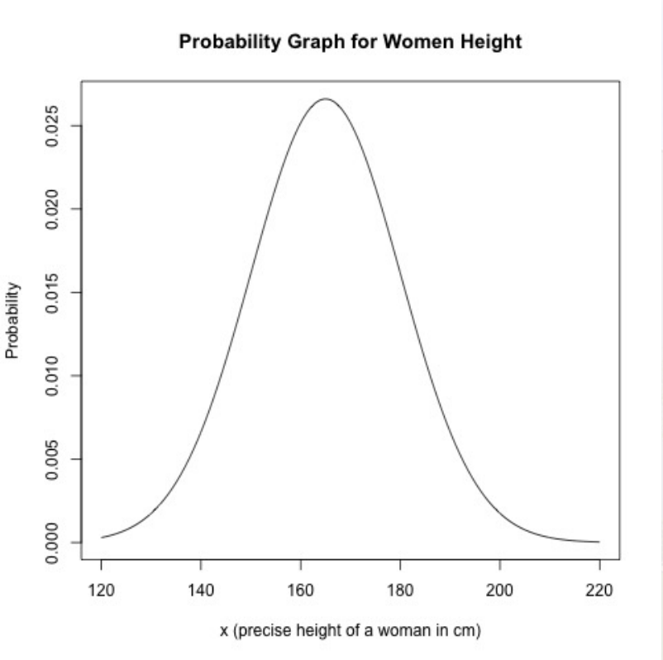
PROBABILITY DISTRIBUTION GRAPH
Also called a density curve
Point on the curve will have (x, y) coordinates if y is the probability of the random variable taking the value x.
Every point of the curve must have a y coordinate between 0 and 1
The total area under the curve must be equal to 1
Notes:
A probability distribution gives the probability for each value of the random variable. For a continuous random variable, this is called the graph of probability distribution, or also called a density curve.
Each XY point of this curvy bit corresponds to a particular value of a random variable on the x-axis, and the probability of a random variable taking that value on the y-axis.
Every point of the curve must have a y-coordinate between 0 and 1 (i.e., not going to happen, and certain to happen) and the total area under the curve must be equal to one (because the probability of all possible events occurring sums to 1).
This example of a probability graph or density curve for a random variable which is the height of women. So our population here is the set of all women in the world, and the random variable x assigns a precise height in centimetres to each woman.

Slide 4
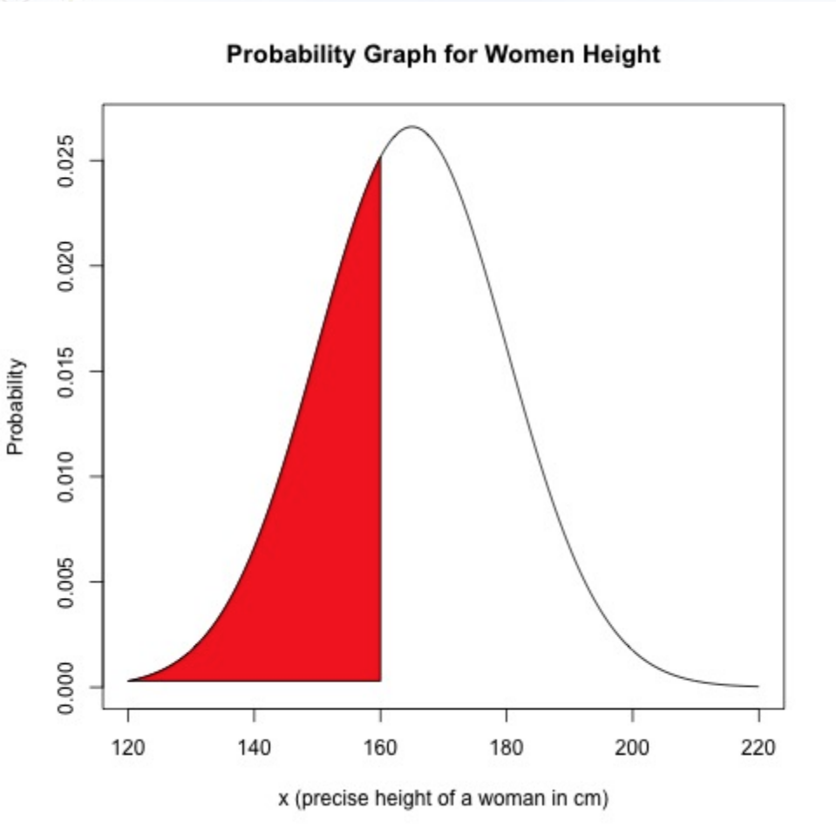
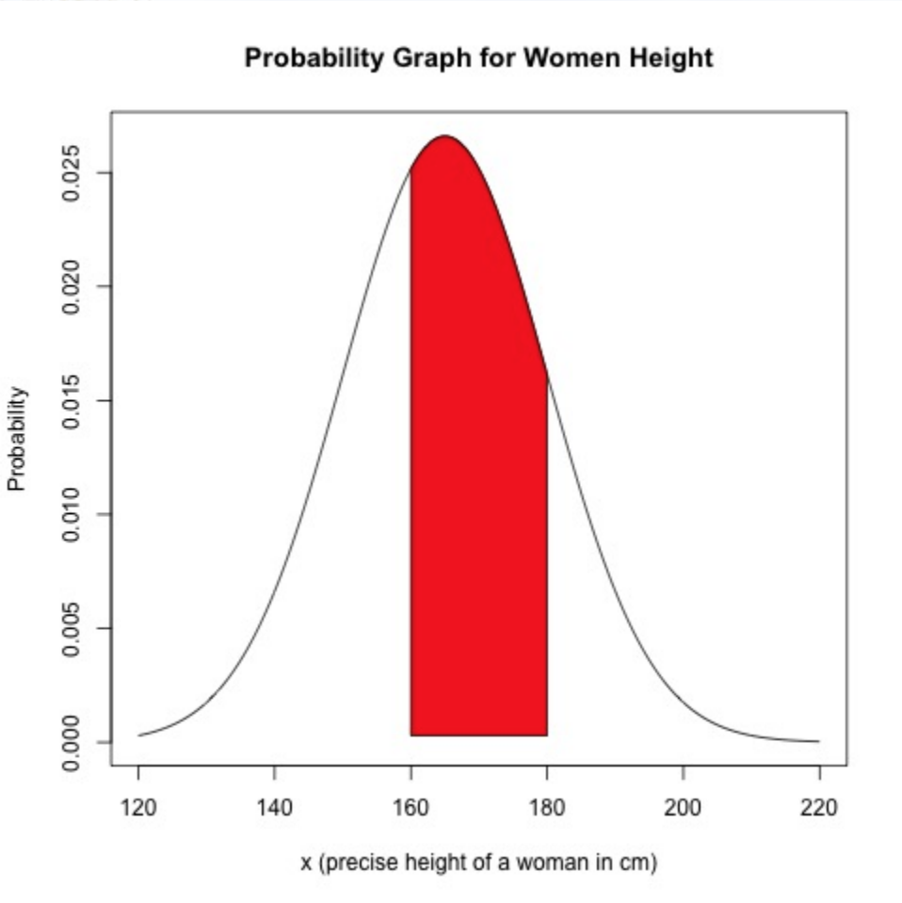




PARAMETERS OF PROBABILITY DISTRIBUTION
What is the probability of a random woman being shorter than 160cm?
$$\sum_{x<160}{P(x)}$$
This is equal to the area under the curve (for which we use integration)
$$\int_{−∞}^{160}{P\left(x\right)dx}$$
Can do this for ranges too, such as $160≤x≤180$
$$\int_{160}^{180}{P\left(x\right)dx}$$
Notes:
We are interested in the range of values that our random variable can take. So, for example, we can ask a question such as “what is the probability of a random woman being shorter than 160cm?” As we’ve defined in previous videos, this is the sum of all probabilities of our random variable taking the set of all these values.
Now, this is not a discrete sum, because height is a real number with infinitely many decimal places, and so instead we take the area under the curve that corresponds to all heights less than 160cm. To get the area under a curve, if you know your Maths, uses the technique of ‘integration’. Specifically, this is a definite integral, which is one that we evaluate between a lower limit and an upper limit.
And this integral exactly corresponds to the area under the density graph to the left of 160 (the bit in red). And this is why density graphs are very, very useful. We might also be interested in the probability of a woman being of a height between one value and another. Taking the definite integral from 160 to 180 gives us the area of this red slice of the curve.
For some distributions this can be quite straightforward, and for others it can be very hard if not impossible.

Slide 5
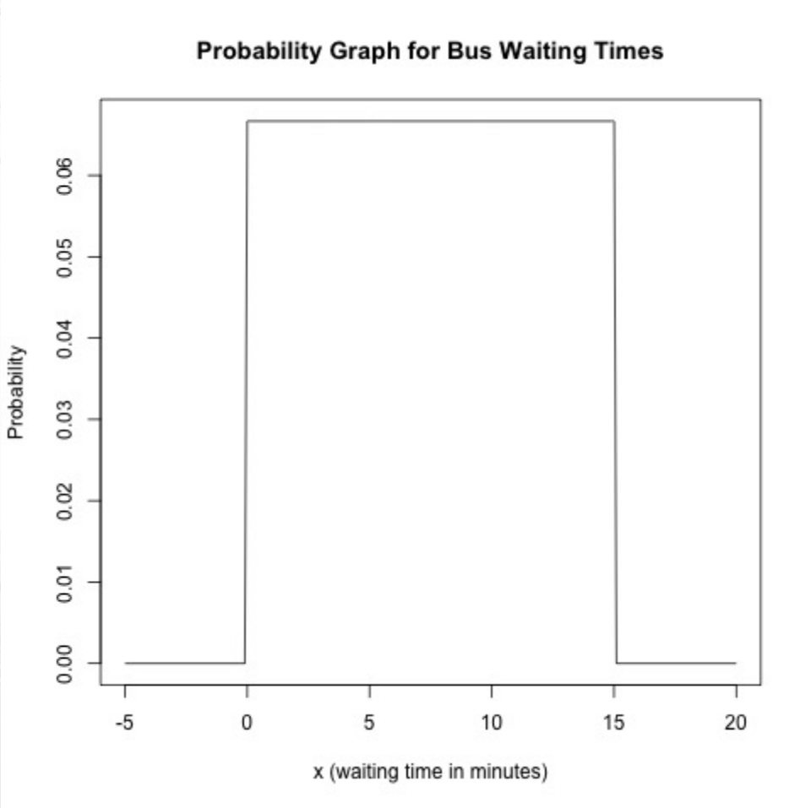
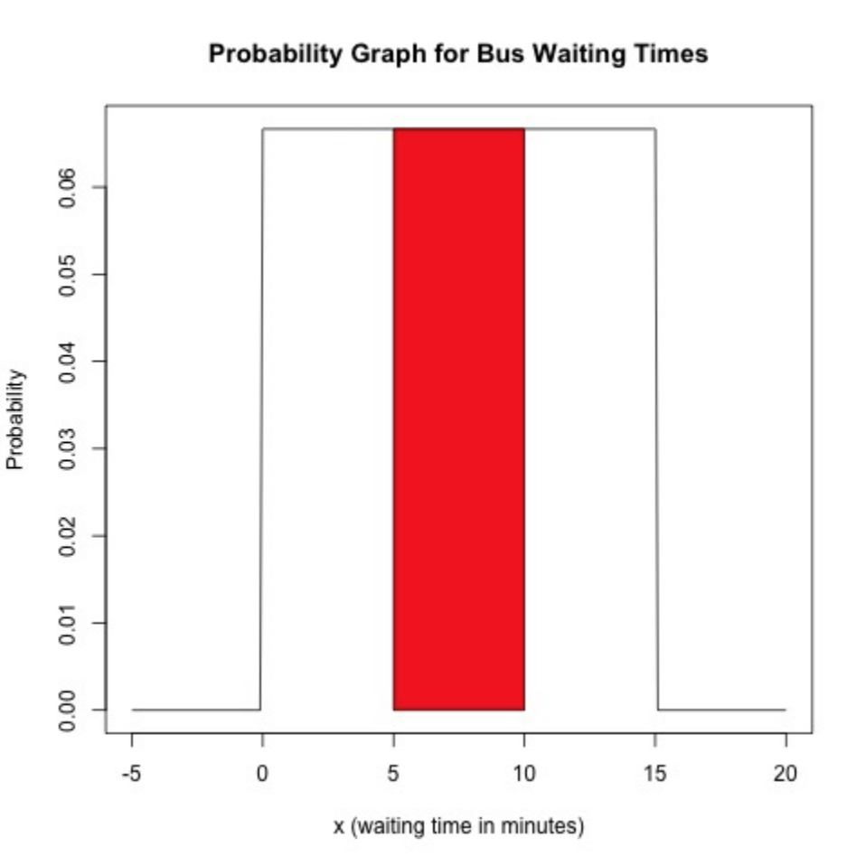
UNIFORM DISTRIBUTION
A continuous random variable has a uniform distribution if each possible value of it has the same probability.
Bus waiting times – uniform distribution
Probability of waiting between 5 and 10 minutes?
No integration needed – straightforward area calculation!
= 5*0.066 = 0.33
Notes:
So we’re going to look at a particularly simple example (in fact it’s difficult to imagine any simpler distribution) wherein each value of our continuous random variable has the same probability. Going back to our bus waiting times example, let’s assume there’s a bus from Dundee to St Andrews every 15 minutes. Assuming we arrive at the bus station at a completely random time, and we don’t know the bus schedule, it is equally likely that we’ll wait anywhere between 0 and 15 minutes. If we also assume that the bus is precise in its schedule, we will NEVER wait more than 15 minutes, and obviously we’ll never wait less than 0 minutes because we’re assuming time travel is impossible.
So to calculate the probability of waiting between 5 and 10 minutes, we don’t need to do any fancy maths – the area under this density curve is just a rectangle of width 5 and height whatever the probability is – in this case 0.066. So the probability is 5 * 0.066, or 0.33, which makes sense because it’s a third of the possible waiting time.

Slide 6


NORMAL DISTRIBUTION
A normal distribution is roughly symmetrical and bell-shaped
$$P\left(x\right)=\frac{e^{−\frac{1}{2}{(\frac{x−μ}{σ})}^{2}}}{σ\sqrt{2π}}$$
Probability function of a normal distribution:
Where 𝜇 is mean and 𝜎 is standard deviation of x, and e is a constant (equal to 2.71828)
$$P\left(x\right)=\frac{e^{−\frac{1}{2}x^{2}}}{\sqrt{2π}}$$
Standard normal distribution (where 𝜇 is 0 and 𝜎 is 1):
Notes:
The uniform distribution is very, very simple, but it's not very commonly used. What is probably the most important continuous probability distribution is one we’ve already seen: the so-called normal distribution.
And so, if a continuous random variable has distribution with density curve that is symmetric and bell-shaped, then we're going to say that it has a normal distribution. This is a very informal definition of a normal distribution (not all bells are the same shape for a start) and the precise definition of normal distribution is that it is the distribution for which the probability function is given by this seemingly complicated formula here.
We have a constant E here, which is Euler’s number and is equal to around 2.7ish. We take this number to the power of minus one half of our random variable x, minus the mean of the distribution, divided by its standard deviation, squared. We then take all that and divide it by the standard deviation multiplied by the square root of two times Pi.
The specific type of normal distribution that we’ll most often use is called the standard normal distribution, where the mean is 0 and the standard deviation is 1. This simplifies our formula quite a bit, but not much.

Slide 7
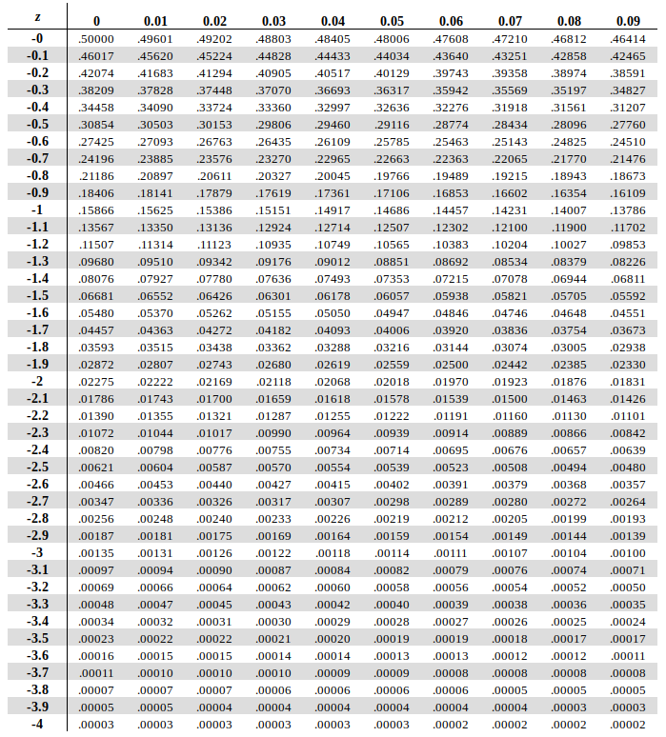


NORMAL DISTRIBUTION PROBABILITIES
$$P\left(x<t\right)=\int_{−∞}^{t}{\frac{e^{−\frac{1}{2}x^{2}}}{\sqrt{2π}}}$$
A bit complicated…
Instead use Z-tables!
Z-score = distance in SDs from mean
Gives, for value Z, probability of random variable with standard normal distribution being less or equal to Z
For non-standard normal distribution, $Z=\frac{x−μ}{σ}$
Notes:
And so to find the area under the curve of a normal probability distribution, we have this integral here, which is a bit complicated.
So there are basically two solutions here. First, and somewhat better, is to use computer software such as R, which has a function that can give you, for a given Z score, the exact area under the density curve, which is lower than that value. And the second option is using something called a Z-table.
These Z-tables for a standard normal distribution is a table that gives you the probabilities of a random variable, with a standard normal distribution, taking a value which is less than some given value. We have a table of negative Z-scores and positive Z-scores. And these are used usually when we don't have a computer at hand to calculate these probabilities. Each value in the Z-table gives the probability of a random variable with a standard normal distribution taking a value which is less than the corresponding Z-score. And as a reminder from last week, the Z-score is the distance in standard deviations from the mean. The score of a particular value tells us how far that value is from the mean, and thus how probable it is. We’re going to be looking at using these in our labs and tutorials, but in essence it’s a simple case of looking up a value in a table, which is much easier than doing a complex integration calculation.
Of course, not all our normal distributions (and indeed most of them) are not standard normal distributions, and so we calculate our Z-score for a given value X using the formula here that we looked at in the previous week. We then look up the corresponding Z-score in the Z-table and find out how probable that value x is. And this is something that we are going to use very, very extensively in the process of testing hypotheses.

